Slide 1
Population Description of Sub-Saharan Africa (Southern Africa) and South Asia (India) in terms of their racial and Ethnic Groups
Name
Institution of Affiliation

Slide 2
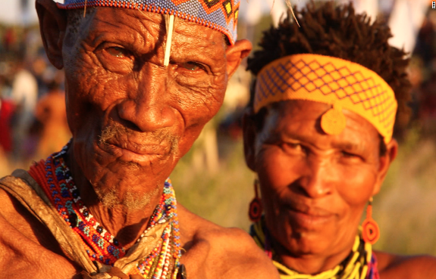
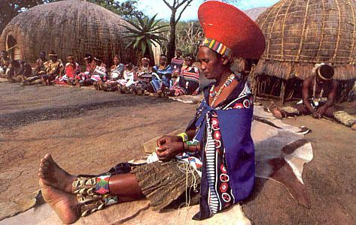
Sub-Saharan Africa (Southern Africa)
The Sub Saharan Africa region is an area in the African continent that is on the south of the Sahara Desert for example Zimbabwe.
The region is comprised of over 1,000 languages. There are the Afro Asiatic speaking groups who are found in the Horn of Africa. The Cushitic subgroup of the Afro-Asiatic is at the Horn where Somalia is located and also in the Nile Valley..
In the Southern part of Africa, there are indigenous speakers of the Khoi-San language. These are termed as Bushmen in the southern part and the Sandawe and Hadza in South East Africa.
In Southern Africa the Bantu speakers are dominant, and they include languages like the Zulu, Shona, Sotho in Lesotho, and Tswana in Botswana.

Slide 3
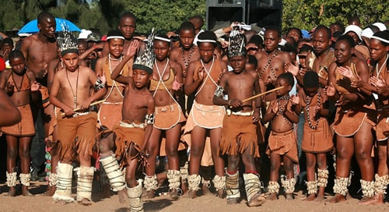
Sub-Saharan Africa (Southern Africa)
Sub Saharan Africa comprises of mostly Christian inhabitants. Those above the Sahara are primarily Islamic. However, there are Muslims in parts of the Horn of Africa for instance in Djibouti and Somalia.
The cultural practices of the sub-Saharan African people are diverse. In South Africa for example, the cultural traditions are still practiced regarding clothing, cuisine and gender roles among others
Sub-Saharan Africa, having inhabited by Bantu speakers, has ancestry to it. The Bantu speakers occupied Central Africa, the African Great Lakes region up to Southern Africa.

Slide 4
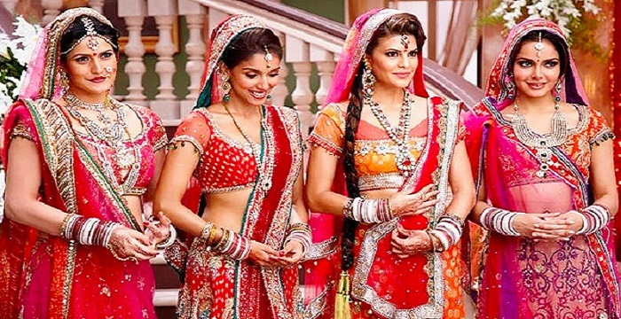
South Asia (India)
South Asia also known as the Indian subcontinent is the southern region of Asia as a continent. It comprises countries like India, Afghanistan, Pakistan, Bangladesh, among others.
The people of South Asia are mainly Hindu with Hindi being the dominantly spoken language. Other languages include Punjabi, Gujarati, Tamil, Bengali, and Telugu.
Culturally, India is recognized for its religious diversity, mythology, literature, dressing and cuisine. To date, India still practices yoga. They practice music with different traditional and religious styles.

Slide 5
References
Bose, S., & Jalal, A. (2017). Modern South Asia: history, culture, political economy. Routledge.
Comaroff, J. (2013). The Body of power, the spirit of resistance: The culture and history of a South African people. University of Chicago Press.
Morrell, R., Jewkes, R., & Lindegger, G. (2012). Hegemonic masculinity/masculinities in South Africa: Culture, power, and gender politics. Men and Masculinities, 15(1), 11-30.

